Slide 1

CHUTING WANG
MECHANICAL ENGINEERING DESIGN PORTFOLIO
WatIAM: c583wang
Waterloo ID: 20833432
Program: Mechatronics

Slide 2

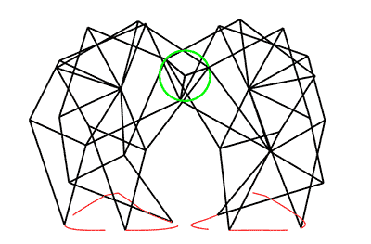
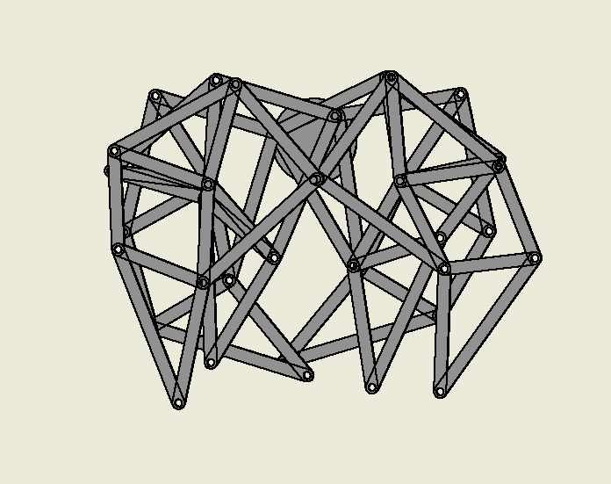
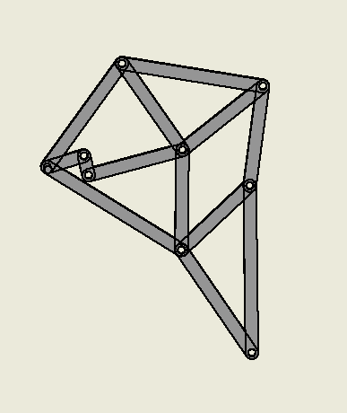
STRANDBEEST Inventor
Therefore, I made a copy of Treasure Chest to study Lei’s color.
1

Slide 3
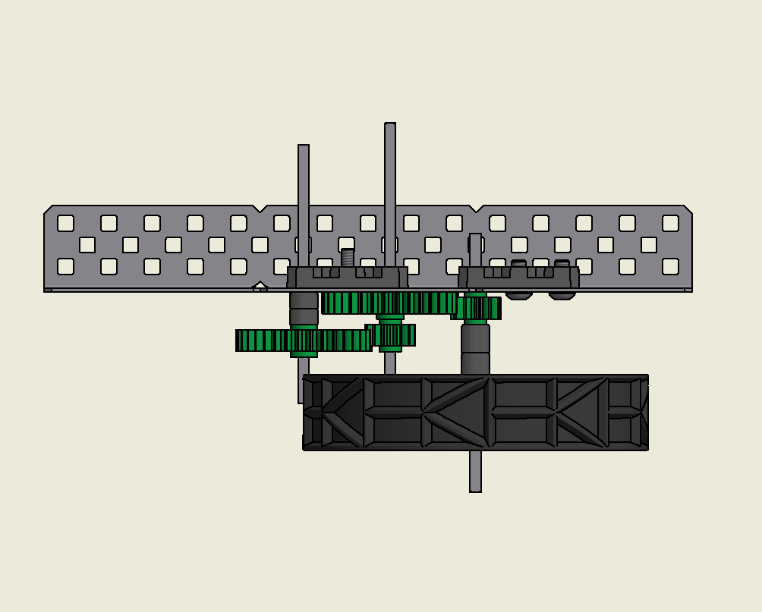
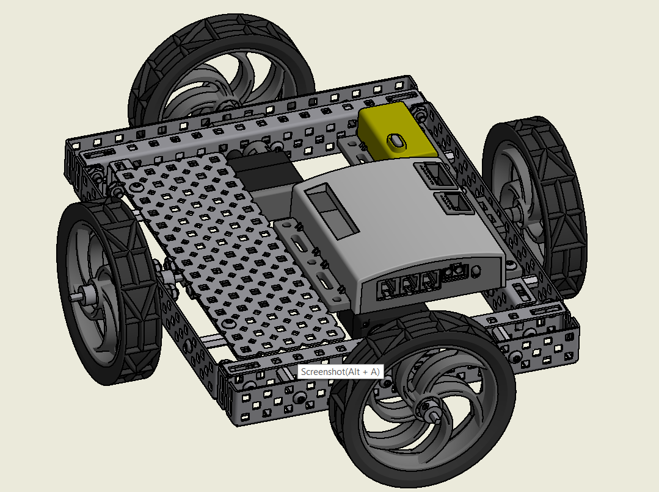
FOUR-WAY ROBOT Inventor & VEX robotics
Therefore, I made a copy of Treasure Chest to study Lei’s color.
Gear Ratio

Slide 4
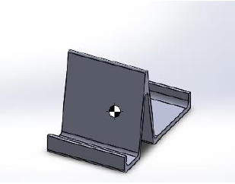
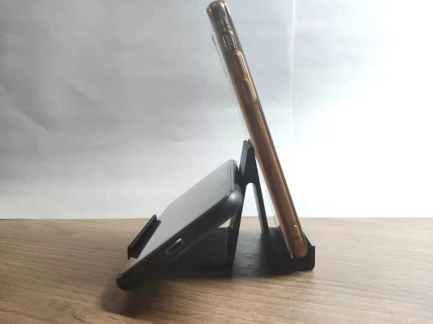
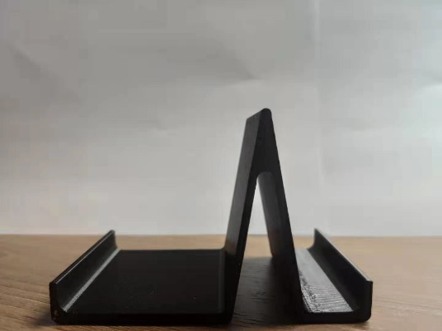
CELL PHONE STAND SolidWorks & GrabCAD Print
Fabrication & Reflection
Therefore, I made a copy of Treasure Chest to study Lei’s color.

Slide 5
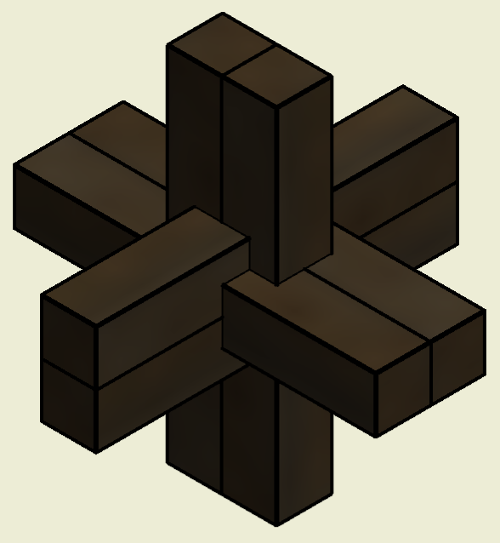
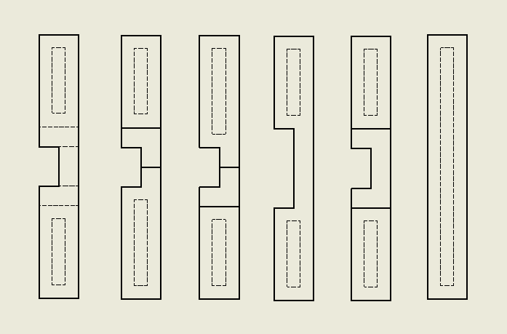
BLOCK PUZZLE Inventor
Therefore, I made a copy of Treasure Chest to study Lei’s color.

Slide 6
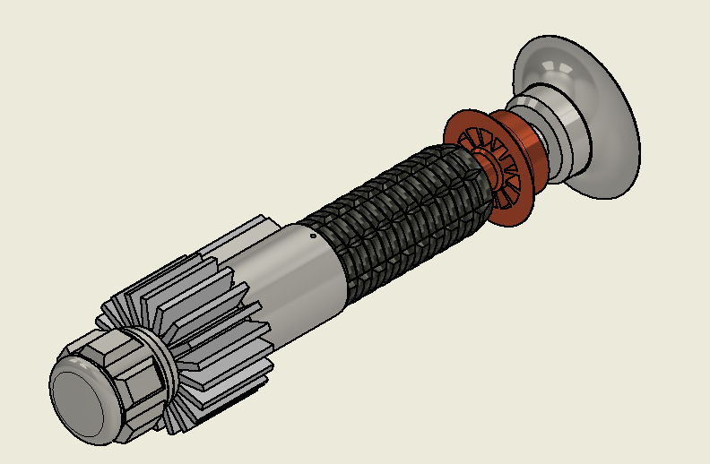
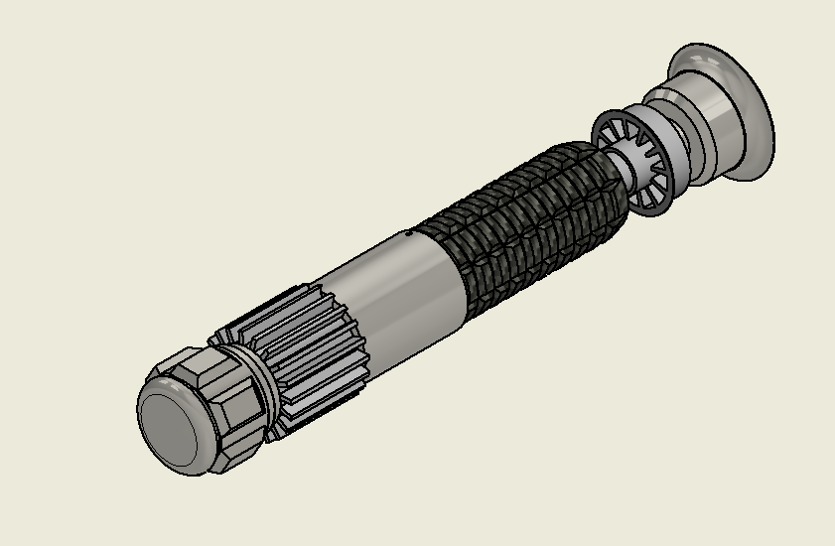
LIGHT SABER ASSEMBLY Inventor
High Power Light Saber
Therefore, I made a copy of Treasure Chest to study Lei’s color.
Light Saber

Slide 7
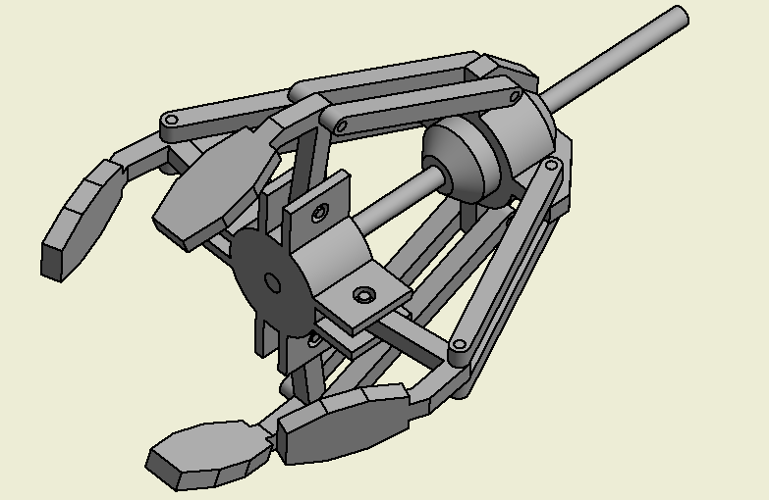
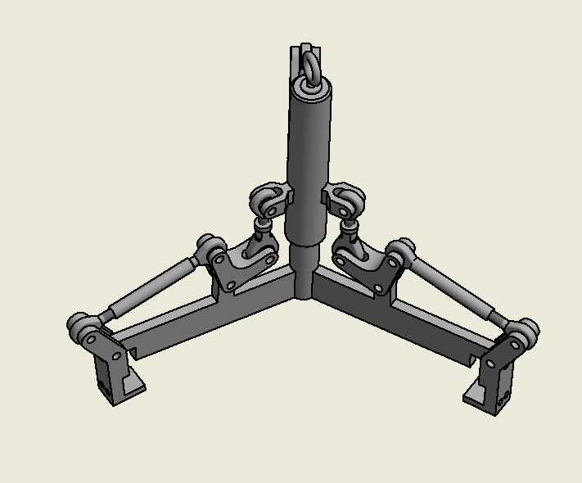
GRIPPER Inventor & SolidWorks
Therefore, I made a copy of Treasure Chest to study Lei’s color.
Inventor LIFTER MECHANISM
Therefore, I made a copy of Treasure Chest to study Lei’s color.

Slide 8
Reference

